Slide 1
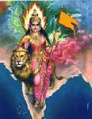
Hindus Temples
Influences
ravisydney@yahoo.com,
www.hindugenius.blogspot.com

Slide 2
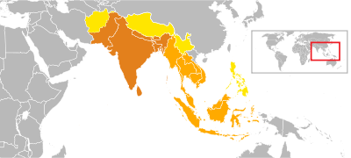
Greater India
Greater India
Dark Orange Indian Sub-continent
Light Orange Culturally Linked to India (Burma, Thailand, Cambodia, Laos,
South Vietnam, Indonesia, Malaysia, Brunei, Singapore
Yellow Significant Cultural Indian Influence
(Afghanistan, Tibet, Yunnan, Philippines,

Slide 3
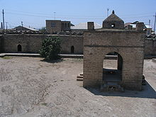
Temples of Azarbaijan North Asia
Atashgah of Baku, Azarbajian
Fire Temple used by Hindus and Zorastrians
a
a

Slide 4
Hindu Kingdoms
&
Civilizations in
Greater Bharat

Slide 5
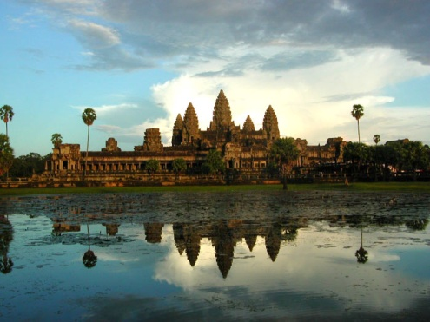
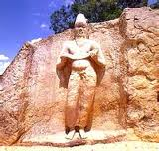
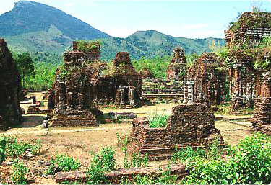
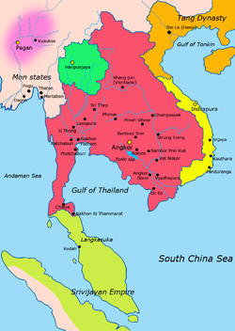
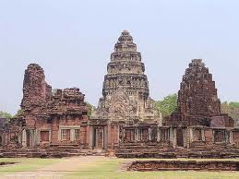
Hindu Kingdoms
Vietnam, Cambodia, Laos, Thailand
Funan Civilization
South Vietnam, Cambodia
1st Century BC – 628 AD
Kaundinya
Champadesa
Central Vietnam
192 - 1832 AD
Sanskrit, Cham
Capital Cities
875 – 978 Indrapura
978 – 11485 Vijaya
1485 – 1832 Panduranga
Khmer Civilization
Cambodia
802 – 1431 AD

Slide 6
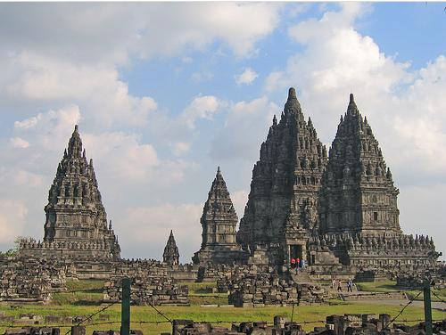
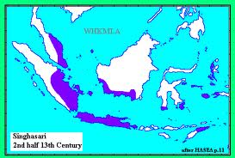
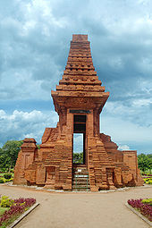
Hindu Kingdoms In Indonesia, Malaysia, Brunei, Philippines
Sri Vijayan Kingdom
Sumatra, Malaysia
7th to 13th Century
Singhasari Kingdom
Java, Bali, Philippines
1222 – 1292 AD
Majapahit Empire
Java, Bali, Philippines
1293 – 1500 AD

Slide 7
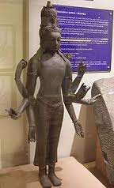

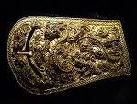
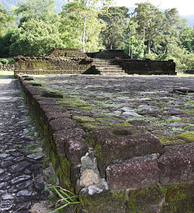
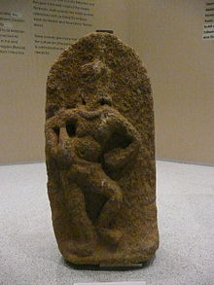
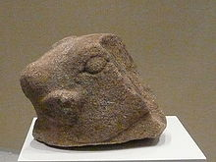
Hindu Kingdoms
Malaysia Singapore, Thailand
Gengga Negara
Malaysia
2nd – 11th Century
Langkasuka Kingdom Malaysia
2nd – 14th Century
Kadaram / Old Kedah Kingdom
Malaysia
630 – 1136 AD

Slide 8
Hindu Civilizations In South East Asia
Central Vietnam
Champa Civilization
Cambodia
Funan Civilization
Cambodia
Khmer Civilization
Malaysia
Langkasuka Kingdom
Malaysia
Gengga Negara
Indonesia - Sumatra
Sri Vijayan Kingdom

Slide 9
Hindu Temples in
East Asia

Slide 10
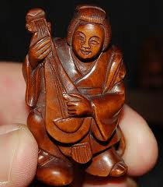
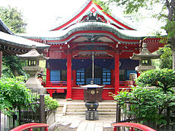
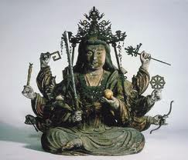
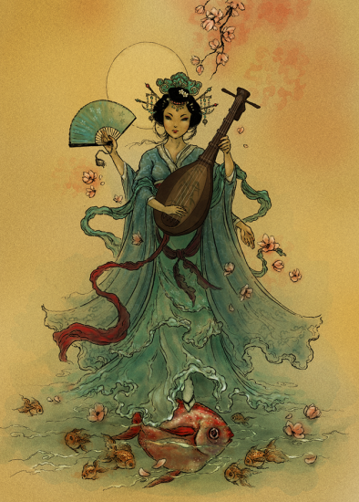
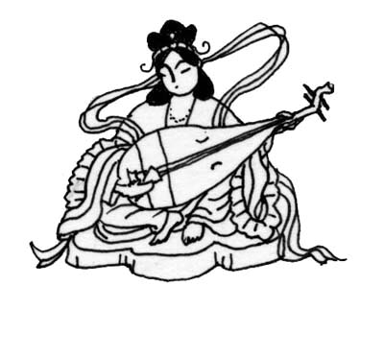
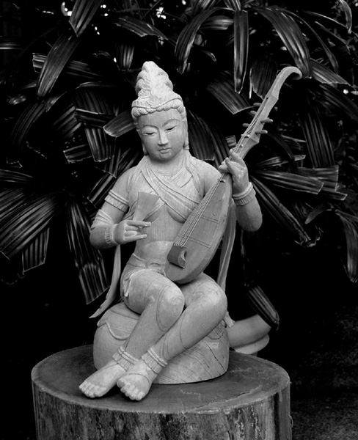
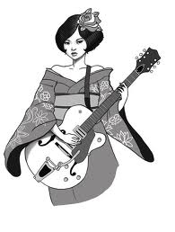
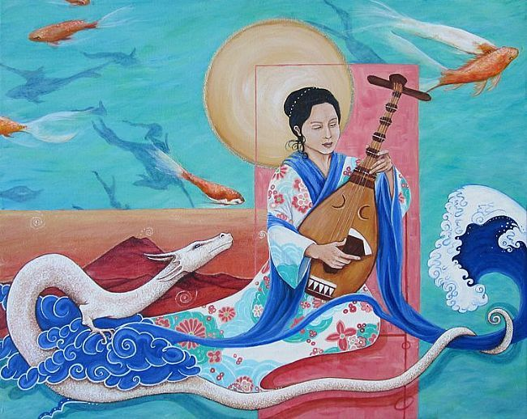
Saraswati / Benzaiten in Japan
Benzaiten shrine,
Inokashira Park
Benzaiten
Sarasvati,
6th Century

Slide 11
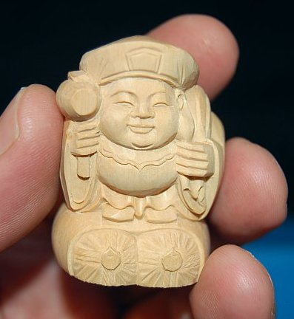
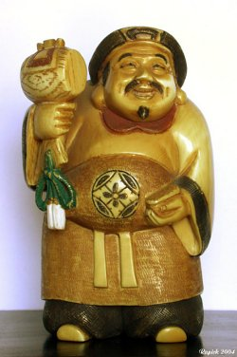
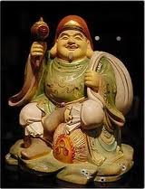
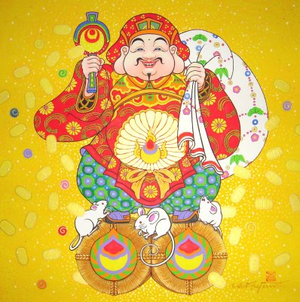
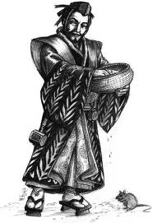
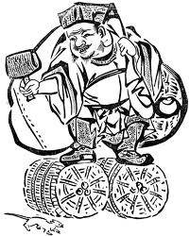
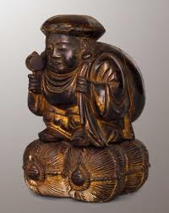
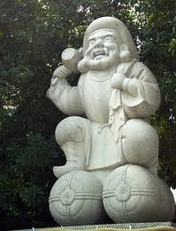
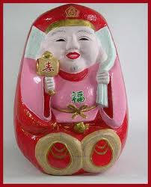
Daikoku / Shiva in Japan
The Great Black Deity = Mahakal
One of the 7 Propitious Gods, God of War, Wealth, Harvest (Sutra of Wisdom)

Slide 12
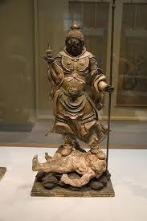
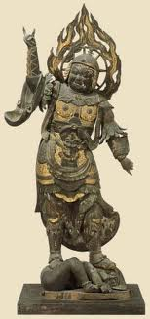
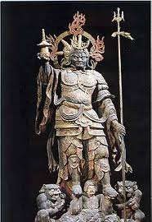
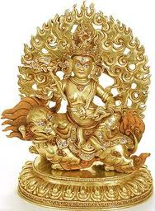

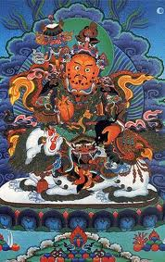
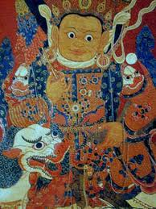
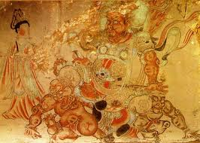
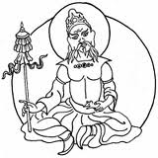
Bishamon / Vaiśravaṇa or Kubera in Japan

Slide 13
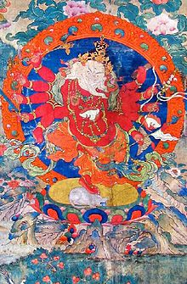
Lord Ganesha Around The World
Tibetan Ganesha
Maha Rakta
(tsog gi dag po, mar chen. English: The Great Red Lord of Hosts or Ganas)

Slide 14
Hindu Temples in
South East Asia

Slide 15
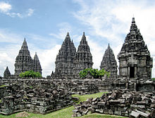
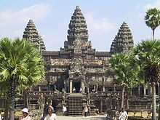
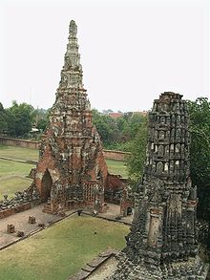
Temples of SEA
PRAMBANAN, Central Java, Indonesia
Shivaistic Temple near Yogyakarta,
Largest Hindu temple in Indonesia
10th century
Wat Angkor,
Cambodia
One of the largest temples in the world
Ruins of Ayuthhaya
Thailand
Named after Ayodhya

Slide 16
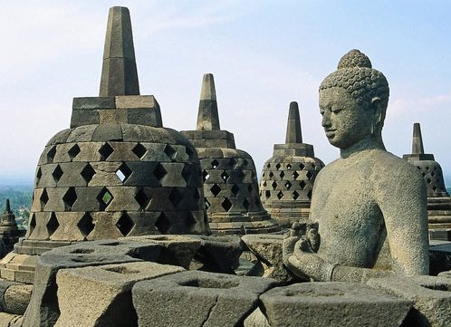
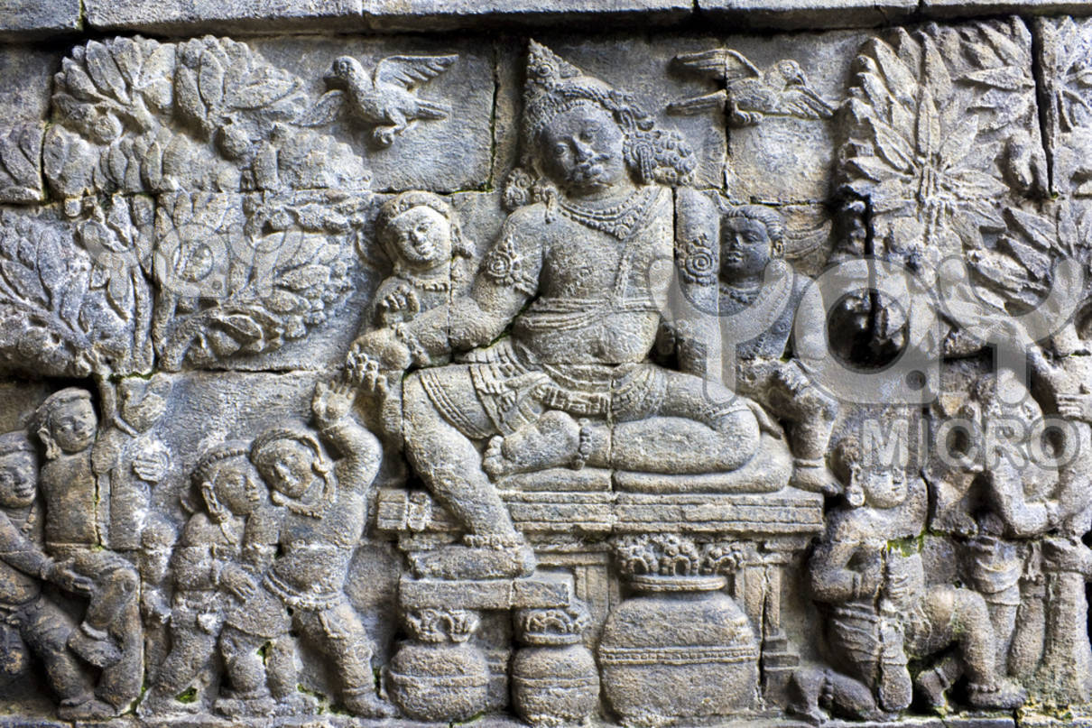
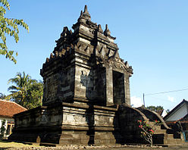
Three Buddhist Temples of Central Java, Indonesia
8th – 9th Century, Sailendra Dynasty
Borobudur
Kamadhatu,
Rupadhatu,
Arupadhatu
Pawon
in line with Borobudur & Mendut
Mendut Temple
King Indra of Sailendra Dynasty
Jataka Tales, Bas Reliefs

Slide 17
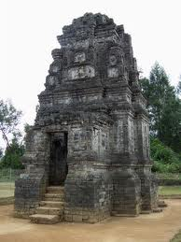
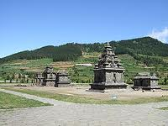



Dieng Plateau - Hindu Temples
Central Java, Indonesia
Dieng Plateau Oldest Temples in Indonesia
750 AD
Candi Bima
Candi Arjuna
Kailasa, DP

Slide 18





Sewu Buddhist Temples
Central Java, Indonesia
Sewu Temple or Manju sri Grha
Mandala Pattern 8th Century AD
Bodhisattva
Candi Sewu

Slide 19





Prambanan – Hindu Temples of Central Java, Indonesia
PRAMBANAN Temple – for Trimurti
Shivaistic Temple near Yogyakarta,
Largest Hindu temple in Indonesia
10th century
Mahishasura Mardini
a
Ravana kidnapping Sita Devi

Slide 20

Mother Temple of Besakih, Indonesia
Hindu Island of Bali

Slide 21





Lord Ganesha in Thailand
Nakhon Nayok
As Tall as 4-5 Story Building
Nakhon Nayok
Thai Buddhist Monk Blessing Devotees
Most devotees are Thais or Chinese

Slide 22

Hindu Gods
Lord Ganesh,
Lord Brahma,
Lord Vishnu,
Lord Shiva
Thailand Postage Stamps

Slide 23



Hindu Imprints in Thailand
Samudra Manthan Scene at Swarna Bhumi Intl Airport and Bangkok
Samudra Manthan Scene from Hindu Puranas at
Swarna Bhumi Airport in Bangkok, Thailand.
Let Noble Thoughts Come to us from all Directions- Rig Veda
23

Slide 24




Hindu Imprints in Thailand
Sanskrit Names of Persons and Cities
Samudra Manthan Scene at Swarna Bhumi Intl Airport and Bangkok
Present Thailand King is called
“Bumipal Atulya Tej, Rama IX” and his daughter composes Poems in Sanskrit.
World’s largest Ramayana Painting on the walls of Emerald Buddha Temple inside Bangkok Palace.
Garuda National Symbol
Thai Ramayan
Vali Sugreev Yudha
Let Noble Thoughts Come to us from all Directions- Rig Veda
24

Slide 25

Lord Vishnu Temple, Angkor, Cambodia
Largest Temple in the world
Suryavarman – II 12th century Khmer Art

Slide 26

Prambanan Shiva Temple, Indonesia
Central Java

Slide 27

Malaysia
Batu Caves in Kuala Lumpur
Batu Caves Complex
15 KMs from Kuala Lumpur
Thai Pusam in a big way

Slide 28

Sri Murugan Temple, Malaysia
Batu Caves, Kuala Lumpur

Slide 29

Sri Raja Kaliamman Temple, Malaysia
Johor Baru, Only Glass Temple

Slide 30
Ramayana in
South East Asia

Slide 31










Laos Ramayan
Phra Lak Phra Lam – 200 BC

Slide 32










Cambodia Ramayan - Ramakerti

Slide 33









Thai Ramayan – 13th century

Slide 34











Islamic Indonesian Ramayan - 870 AD
9th Century Ramayana in Java & Bali
Kakawin Ramayana, Yogesvara Ramayana, Ravanavadham of Bhatti,
Wayang Kulit – Shadow Play

Slide 35








Islamic Malaysian Ramayan
Hikayat Seri Rama – 13th century

Slide 36




Ramayan – Burma, Philippines
Philippines Ramayana
Maharadiya Lawana
&
Darangan
Myanmar Ramayan
Yama Zatdaw

Slide 37
Hindu
Influence in Modern Times

Slide 38





Ramayan Imprints in China
Bodhi Dharma of Kanchipuram 500 AD, taught in China Zen Buddhism and 16 ways of Martial Arts.
Huyen Tsang
Chinese Scholar spent 12 years in Bharat and took thousands of manuscripts to China
Ji Xianlin,
Chinese Sanskrit Scholar
on Ramayan,
Padma Bhushan 2008.
Chinese PM Wen Jiabo
recited ‘Aum Sahana Vavatu’
before Chinese Politburo
Chinese Ramayan Cartoons

Slide 39






Ramayan –UK, Europe
Bhaktivedanta UK
RAAM Currency for World Peace. 1 RAAM = 10 Euro $ and these bonds are convertible at Fortis Bank in Roermond, the Netherlands.
Diwali UK,
Lighting
London Parliament
London, UK
State Funded Krishna-Avanti Hindu school at a cost of
$19.5 million (Rs 100 Crores).

Slide 40








Deepavali In Parliaments
Diwali Singapore
Lighting
Little Madras
Diwali Canada
Lighting Parliament
Diwali Australia,
Lighting
Canberra Parliament
Diwali USA
Lighting White House
Diwali New Zealand,
Lighting
Wellington Parliament
Diwali Barbie
USA
Diwali Australia,
Lighting
Sydney Parliament
Diwali UK,
Lighting
London Parliament

Slide 41
Ramayan in Bharateeya Languages
NEPALI Mahakavi Siddhidas Mahaju 1000 AD
NEPALI Bhanu Bhakta Acharya 19th century
TAMIL Kamban 12th century wrote Ramavataram / Kambaramayanam
HINDI / AWADH Tulasi Das 1576 AD wrote Sri Ramacharit Manas
BENGALI Krittivas 14th century,
ORIYA Balarama Das 16th century,
ASSAMESE Madhava Kandali 14th century wrote Kotha Ramayana
GUJARATI Premanand 17th century.
MARATHI Sridhara 18th century,
TELUGU Ranganatha 15th century,
KANNADA Narahari 16th century wrote Torave Ramayana
KANNADA Rashtrakavi Kuvempu 20th century Sri Ramayana Darshnam
MALAYALAM Thunchaththu Ezhuthachan 16th century
Adhyathma Ramayanam Kilippattu
MUSLIM RAMAYANA
Mappilla Pattu / Mapilla Ramayana—a genre of song popular among the Muslims belonging to Kerala and Lakshadweep—has incorporated some episodes from the Ramayana into its songs.

Slide 42
Lord Ganesha in Thailand
Nakhon Nayok
As Tall as 4-5 Story Building
Nakhon Nayok
Thai Buddhist Monk Blessing Devotees
Most devotees are Thais or Chinese

Slide 43





Hindu Imprints in Indonesia, world’s largest Muslim Country
Lord Ganesha and Garuda on Indonesian Currency–year 1998
Bali Temple
Borobudur
Prambanan Temple
Garuda Airways

Slide 44




Lord Krishna and Arjuna
on a chariot with 8 horses.
City Center,
Jakarta, Indonesia
Garuda Wisnu Kencana Bukit Bali

Slide 45




Hindu Influence in Indonesia
Bali
Ghatotkacha, son of Bhima, in
Ngurah Rai International Airport, Bali.
Bali
Bhima
Bali
Besakih,
Mother Temple
East Java
Panataran Temple (12th Cent.)

Slide 46


Hindu Imprints in Cambodia
Hinduism & Ramayan since 1st Century AD
Cambodians pioneers of spreading Ramayana
in many parts of South East Asia
Wat Angkok, World’s largest Temple Complex
Cambodian Ramayan
is 2,000 years old.

Slide 47




Vietnam Ganesh
Hindu Temple
Hinduism in Vietnam
Cambodia
Lord Shiva

Slide 48



Hindu Imprints in Malaysia, Brunei
Ministers take oath in the name of
“Urusan Seri Paduka Baginda”
‘by the orders of the
Paduka of Lord Rama’
Sultans called Raja Parameswara
and his wife is called Parameswari.
Their second son is addressed as Lakshmana.
Capital of Brunei is ‘Bandar Seri Bagwan’
World’s tallest Bldg.
Owned by
Ananta Krishnan
Hindu Temple

Slide 49


Hindu Imprints in China, Japan, Myanmar
Bodhi Dharma of Kanchipuram 500 AD, taught in China Zen Buddhism and 16 ways of Martial Arts.
Huyen Tsang
Chinese Scholar spent 12 years in Bharat and took thousands of manuscripts to China
Chinese Ramayan Cartoons
Japanese Buddha
Myanmar Ramayan

Slide 50

Lord Nataraja at CERN, Geneva
"It is the clearest image of the activity of God which any art or religion can boast of" ...

Slide 51
Raam Currency
Holland & USA
1 Raam = 10 Euro $,

Slide 52
Sanskrit
Bhagwad Gita
Yoga
Ayurveda
Bharata Natyam

Slide 53
Golden Age of Hinduism
Bhagwad Gita in USA Unive
Staten Hall University
10,000 students studying
Sanskrit in UK Schools
To Improve Pronunciations (Training the Tongue)

Slide 54
Deepavali In Parliaments
Diwali Singapore
Lighting
Little Madras
Diwali Canada
Lighting Parliament
Diwali Australia,
Lighting
Canberra Parliament
Diwali USA
Lighting White House
Diwali New Zealand,
Lighting
Wellington Parliament
Diwali Barbie
USA
Diwali Australia,
Lighting
Sydney Parliament
Diwali UK,
Lighting
London Parliament

Slide 55







Yoga Around The World
Abdul Kareem Jabbar
World Basket Ball champion runs Yoga college – 16 Million practice yoga in USA – 6 Billion $ business
Quincy Jones
Oscar Award winning
Music Director cured Malignant Tumor with
Yoga & Meditation
Madonna
Practices Yoga and
sings Sanskrit Hymns
Australian Crcket Team
defeated India in 35 Years
By Practicing Yoga
Ayurveda & Bharata Natyam
Ayuvedic Burqa,
Popular in
Saudi Arabia
Ramli Ibrahim & Chandra Banu
Malaysia

Slide 56





Vedas & Bhagwad Gita
US Senate
& State Parliaments
inaugurate
with Vedic Chantings
Alfred Ford
USA
spreads Hinduism,
Julia Roberts
Oscar winning actress
takes to Hinduism
Children Maha Laxmi, Ganesh, Krishna Balram
Steve Jobs, USA
Ipod, Iphone, Apple Computers Wears
Kurta, Pyjama, Dhoti
USA
Noble Prize 2009
Nobel Laureate
Venky Ramakrishnan

Slide 57
Vedas & Bhagwad Gita
US Senate
& State Parliaments
inaugurate
with Vedic Chantings
Alfred Ford
USA
spreads Hinduism,
Julia Roberts
Oscar winning actress
takes to Hinduism
Children Maha Laxmi, Ganesh, Krishna Balram
Steve Jobs, USA
Ipod, Iphone, Apple Computers Wears
Kurta, Pyjama, Dhoti
USA
Noble Prize 2009
Nobel Laureate
Venky Ramakrishnan

Slide 58
Vedas & Bhagwad Gita
US Senate
& State Parliaments
inaugurate
with Vedic Chantings
Alfred Ford
USA
spreads Hinduism,
Julia Roberts
Oscar winning actress
takes to Hinduism
Children Maha Laxmi, Ganesh, Krishna Balram
Steve Jobs, USA
Ipod, Iphone, Apple Computers Wears
Kurta, Pyjama, Dhoti
USA
Noble Prize 2009
Nobel Laureate
Venky Ramakrishnan

